Slide 1

HubSpot sales hub - product insights
Customer churn analysis
September 2020

Slide 2

Agenda
Introduction
Data & Assumptions
User Actions
What can be done?
Closing

Slide 3

Introduction
Objectives for Analysis
HubSpot Sales Hub is seeing users sign up for the product and then stop using the product after one day.
Today, we’ll learn more about what these people do with the product before ‘abandoning ship’ & understand what can be done to improve.

Slide 4

Data & Assumptions
Let’s Dive In

Slide 5

About the data set
COUNT OF RECORDS | MONTHS | WEEKS | CORE FEATURES UTILIZED
6456 | Sept | Oct | 38 to 42 | 6
DATA MANIPULATION (using PYTHON):
Renamed column name user id → user_id for further analysis.
Introduced a new column ’total_actions’ as the sum of the 6 available stats features.
Changed datatype of ‘stat_week’, ‘m’, ‘d’ & ‘user_id’ from int to string object to avoid unwanted aggregation.
Introduced a new column ‘date’ by combining the ‘d’ date and ‘m’ month columns.
No NULL values in the raw data.
No duplicate User IDs.
All stat feature counts are integers.
Note: Python notebook available as file: Customer_Churn_Analysis.ipynb, HTML format also added in the zip file.

Slide 6

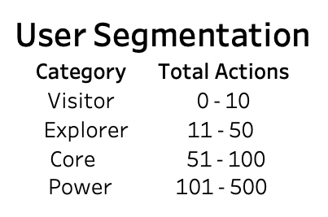
ASSUMPTIONS
Segmentation of users in 4 categories based on Total stat counts.
Based on the below logic, categorized the users into 4 bins.
All the stats on the core features are computed independently and not a subset of one another.
Total stats are computed based on this assumption.

Slide 7

User actions
Let’s Dive In

Slide 8
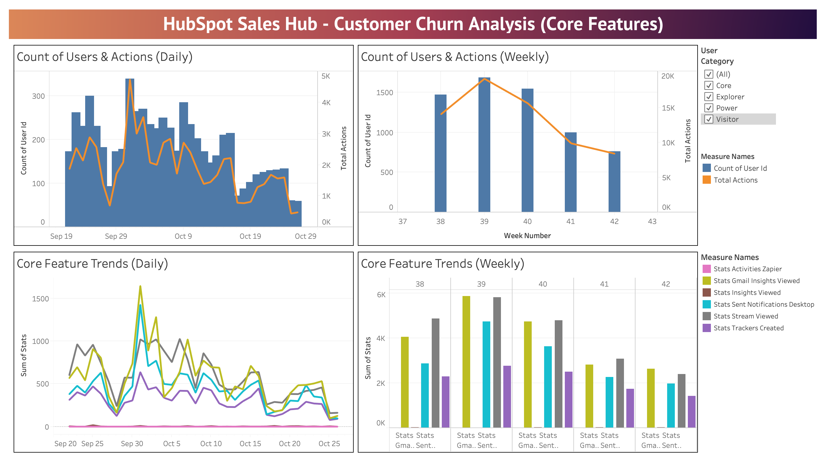
OBSERVED trends

Slide 9
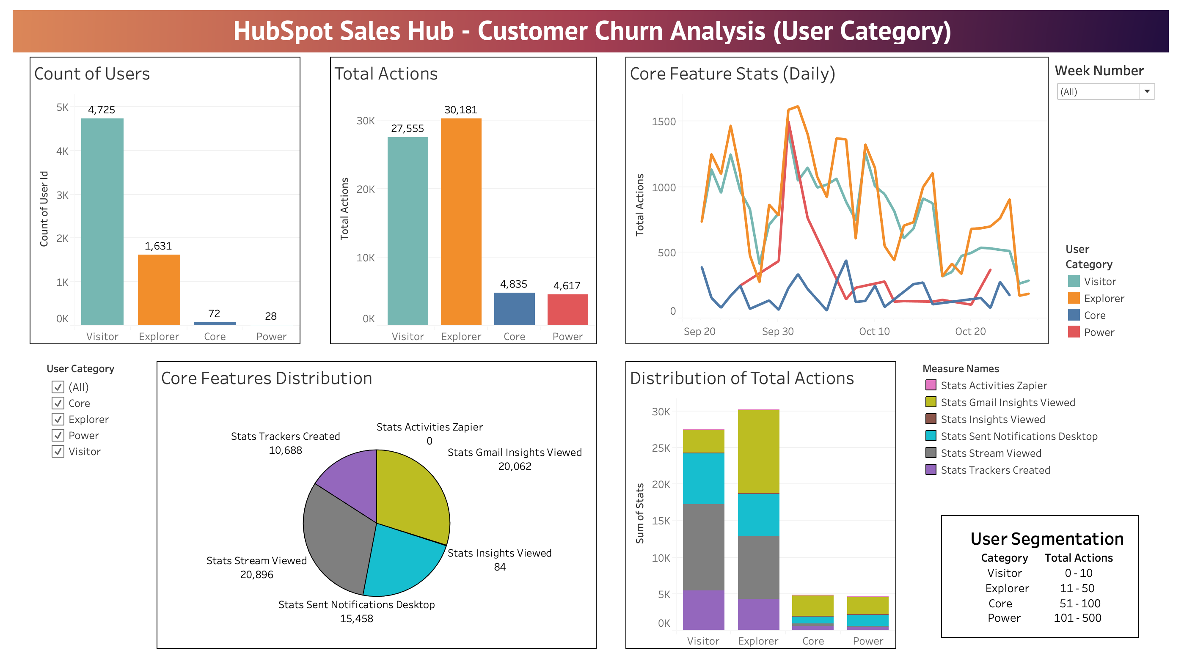
OBSERVED trends

Slide 10




Key insights
USER CATEGORY Nearly 73% of users belong to the Visitor category where Total Stat count <= 10 | ZAPIER INTEGRATION Out of 6,456 users, not a single user has used any of the available Zapier Integrations. | CHURN OVER WEEKS Almost 73% of users churned in Weeks 38, 39 & 40 i.e. Sept 22nd to Oct 12th. | EXPLORER USERS This category has a low user count (1,631) whereas the highest count of Total Actions (30,181).
Note: Tableau Dashboard: HubSpot_CustomerChurnAnalysis.twbx designed using modified CSV file: HubSpot_Data_week1_churn_modified.csv

Slide 11

What can be done ?
LOOKING AHEAD

Slide 12


NEXT STEPS
USER RE-ACQUISITION
Timely follow-ups with customers who churned after 1 day for feedback.
Priority should be given to Explorer, Core & Power Users for feedback.
Minimum resources should be utilized on Visitor category users who might have less chances of conversion.
TRAINING / AWARENESS
More personalized attention, demo prompts, frequent newsletters with information about the product features for the initial usage period.
Zapier Integrations being used by no user highlights the fact that probably the users are not aware of the feature and its use.

Slide 13

NEXT STEPS
ADDITIONAL DATA
User demographic data such as Profession, Purpose of use, Company name and so on should be included in the existing data.
Supporting statistics on user behavior such as time spent on each feature, Device & Browser details can help identifying any compatibility issues in the product.
Analysis should be performed for a longer time period so that the churn trend could be established more firmly. Check if the decrease in churn after week 39 was consistent. If yes, explore if significant changes were made to the product.
Data for ‘Retained’ customers should also be considered for comparison and analyze the difference in trends and activities performed by both group of users.

Slide 14

CLOSING
Measuring retention is very important to learn about how to reduce customer churn.
Analysis based on additional data will help establishing the customer churn hypothesis more clearly
Strategies need to be designed for improving user engagement and re-acquisition.
Technology STACK
Python Programming using Jupyter Notebooks – IBM Watson Studio
Tableau

Slide 15



THANK YOU
AESHA SHAH
+1 (480) 799-8938
aesha.shah@asu.edu
https://www.linkedin.com/in/aesha-s/

